Slide 1
SOLID Principal
S: Single Responsibility Principle (SRP)
- Jitendra Soni

Slide 2
Let’s check the definition
The single-responsibility principle (SRP) is a computer-programming principle that states that every module or class should have responsibility over a single part of the functionality provided by the software, and that responsibility should be entirely encapsulated by the class, module or function. All its services should be narrowly aligned with that responsibility.
Robert C. Martin expresses the principle as, "A class should have only one reason to change,"

Slide 3
Case - 1
Sent Email Functionality –
Wrong Design
Right Design

Slide 4
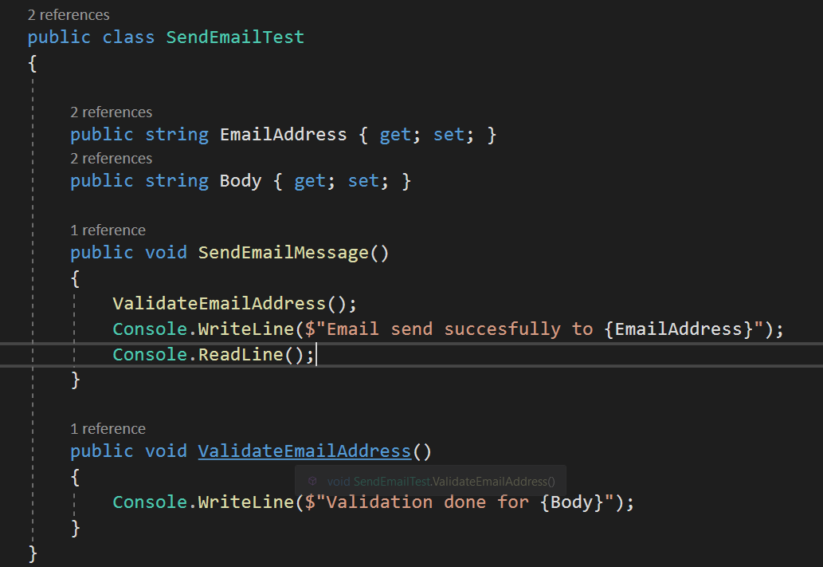

Slide 5
Title and Content Layout with Chart

Slide 6
Two Content Layout with Table
Class | Group A | Group B
Class 1 | 82 | 95
Class 2 | 76 | 88
Class 3 | 84 | 90
First bullet point here
Second bullet point here
Third bullet point here

Slide 7
Two Content Layout with SmartArt
First bullet point here
Second bullet point here
Third bullet point here
Group A
Task 1
Group B
Task 1
Group C
Task 2
Task 2
Task 1
Task 2

Slide 8
Add a Slide Title - 1

Slide 9
Add a Slide Title - 2

Slide 10
Add a Slide Title - 3

Slide 12
Add a Slide Title - 4

Slide 13
Add a Slide Title - 5

